Slide 1
Salesforce.com
Salesforce.com is the world leader in on-demand customer relationship management (CRM) services
Manages sales, marketing, customer service, and support operations using its Sales Cloud and Service Cloud.
Provides powerful capabilities to develop custom applications on its cloud computing platform, Force.com.

Slide 2
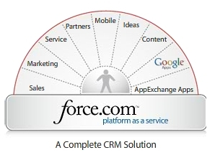

About Salesforce
Salesforce.com is a Customer Relationship Management (CRM) solutions vendor.
Delivered using the software as a service model.
Notes:
Before we begin to discuss the details of salesforce and how it can be useful in your world, I think it is important to first provide you with a brief introduction to the cloud computing and web 2.0 in general in order to give you a full scope of this powerful tool and help better understand the advantages of the CRM. A CRM is a custom relationships management tool, basically think of it as a database that manages the data of a full cycle of a student. With salesforce this CRM is delivered using an online application via the SAAS model. This model is based on, cloud computing, the latest trend in technology.

Slide 3
Salesforce.com CRM Offerings
Consists of Sales Cloud and Service Cloud
Can be broken down into Five Core Applications
  Sales : Empower company to manage people and processes more effectively to focus on sales rather than in administration.
  Marketing: Empowers customers to manage multi-channel campaigns and provide upto date messaging to sales.
  Service : Companies can tab Customer Conversations
  Collaboration : customers, partners, employees can collaborate in the Cloud.
  Analysis : real-time reporting, calculations, and dashboards etc., can be used to optimize performance, decision making and resource.

Slide 4


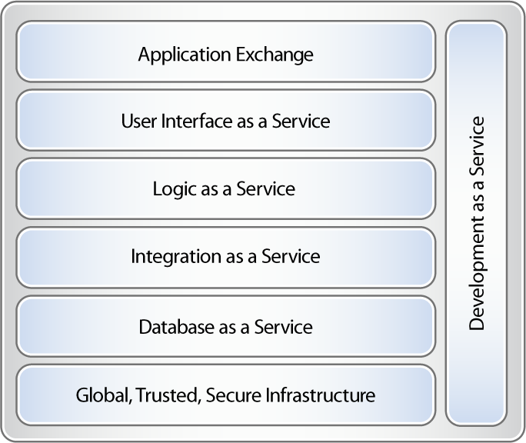
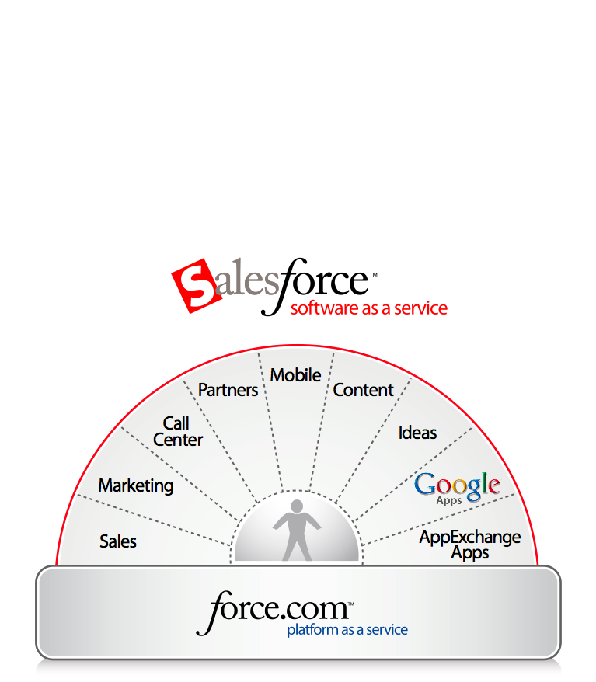
Force.com Offerings
Notes:
Positioning SFDC platform versus applications

Slide 5
Why PaaS?
Application
Services
Infrastructure
Services
Operations
Services
Delivered
Application
Security
Sharing
Integration
Customization
Web Services
API
Multi-Language
Multi-Currency
Workflow
Analytics
Multi-Device
Messaging
Search
Idea
Network
Storage
Operating System
Database
App Server
Web Server
Data Center
Disaster Recovery
Authentication
Availability
Monitoring
Patch Mgmt
Upgrades
Backup
NOC
Notes:
What does it take to create a business class cloud-based application that can survive and prosper?

Slide 6
PaaS lets developers focus on what their apps do, rather than the software and infrastructure to run them
You
Force.com
Infrastructure
Services
Application
Services
Operations
Services
Build Your Apps!
Notes:
Let Apex do the heavy lifting, so you can focus on the fun stuff – innovation, creating apps, etc.

Slide 7
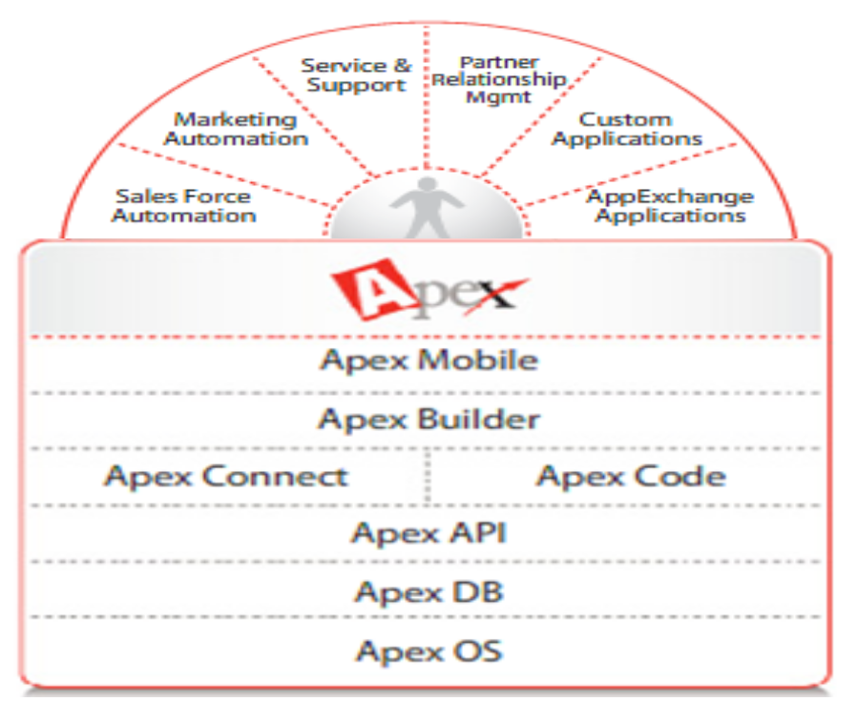



The Force.com API
Overview
Salesforce provides programmatic access to your organization’s information using a simple, powerful, and secure application programming interface, the Force.com Web Services API.
Force.com Mobile
Force.com Builder
Force.com Connect
Apex Code
Force.com API
Force.com DB
Force.com OS

Slide 8

The Force.com API
How does it work?
Login call
  Log in to the login server and receive authentication information to be used for subsequent calls
Force.com Mobile
Force.com Builder
Username/Password
Force.com Connect
Apex Code
http/s
Force.com API
URL/Session ID Token
Force.com DB
Force.com OS

Slide 9
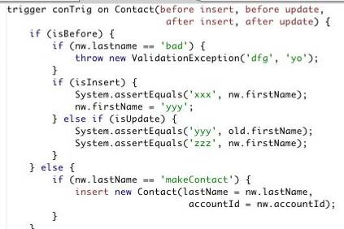

Apex : An integrated development environment
Apex Code is the new on demand, multi-tenant programming language that extends the capabilities of the Apex platform by introducing the ability to write code that runs on salesforce.com servers.
Apex Code can be organized in Classes
Force.com Mobile
Apex Code
Class
Force.com Builder
Force.com Connect
Apex Code
Force.com API
Force.com DB
Force.com OS

Slide 10



Apex Web Services Overview
An Apex Code Class can be exposed as a Web Service by declaring the Package as a “webService”
The webService Apex Code Class becomes an Apex Web Service that can be invoked by any external or internal application
Web Service
Force.com Mobile
Apex Code
Class
Force.com Builder
Force.com Connect
Apex Code
Force.com API
Force.com DB
Force.com OS
Using Apex, Software Engineers can test their applications in Force.com’s Sandboxes and then offer the finalized code on Salesforce.com’s site.

Slide 11
Visualforce
A framework for creating new interface designs and enables building and delivering user interactions with no software or hardware requirements.
Uses HTML, AJAX, and Flex for building business applications.
Provides a page based model that enables the design definition of an application’s user interface.
Provides Components and Logic Controllers to extend and build user interface behavior to meet specific requirements.

Slide 12

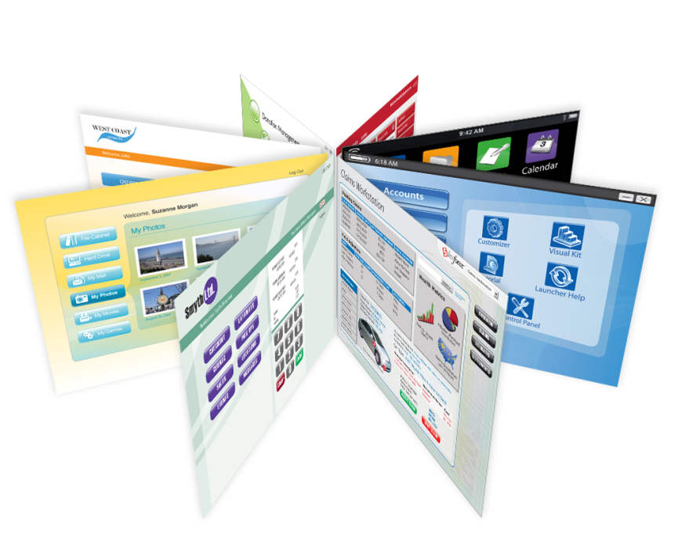
Create Any Application and Any Interface
10,500+ Custom Interfaces Created
Any User Interface
Any Application
Any Device
  Visualforce opens up a new world of possibility for user interface design.
  It helps to build compelling user interfaces packed with powerful business logic.

Slide 13
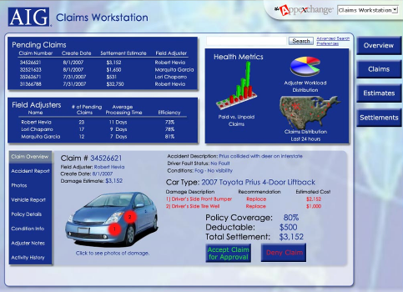
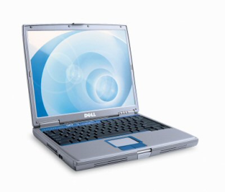

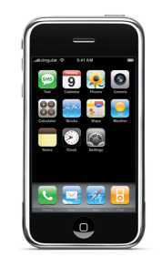
Create Any Application and Any Interface
Any Design
Any Interaction
Any Device

Slide 14
Salesforce.com AppExchange
AppExchange is a directory of applications built for Salesforce.com by third party developers.
Users can purchase and add to their Salesforce.com environment.
AppExchange allows Independent Software Vendors (ISVs) to accelerate their time-to-market and extend on-demand success beyond CRM.
Using AppExchange, companies are able to easily add new applications to their existing Salesforce.com deployements.

Slide 15
Salesforce.com Summary
Salesforce.com is a leader in offering cloud computing CRM applications through SaaS model.
Provides Force.com as PaaS for developing applications by ISVs.
Provides Apex and Visualforce for building applications by ISVs
Provides AppExchange to deploy the applications of ISVs on Salesforce.com
Eliminates the need for developers or partners to create and manage their own datacenter or Infrastructure.

